Slide 1

Introduction to PHP

Slide 2
PHP Arrays
> An array variable is a storage area holding a number or text. The problem is, a variable will hold only one value.
> An array is a special variable, which can store multiple values in one single variable.

Slide 3

PHP Arrays
If you have a list of items (a list of car names, for example), storing the cars in single variables could look like this:

Slide 4
PHP Arrays
> However, what if you want to loop through the cars and find a specific one? And what if you had not 3 cars, but 300?
> The best solution here is to use an array.
> An array can hold all your variable values under a single name. And you can access the values by referring to the array name.
> Each element in the array has its own index so that it can be easily accessed.

Slide 5
PHP Arrays
In PHP, there are three kind of arrays:
> Numeric array - An array with a numeric index
> Associative array - An array where each ID key is associated with a value
> Multidimensional array - An array containing one or more arrays

Slide 6
PHP Numeric Arrays
> A numeric array stores each array element with a numeric index.
> There are two methods to create a numeric array.

Slide 7


PHP Numeric Arrays
In the following example the index is automatically assigned (the index starts at 0):
In the following example we assign the index manually:

Slide 8
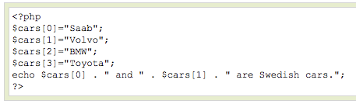

PHP Numeric Arrays
In the following example you access the variable values by referring to the array name and index:
The code above will output:

Slide 9
PHP Associative Arrays
> With an associative array, each ID key is associated with a value.
> When storing data about specific named values, a numerical array is not always the best way to do it.
> With associative arrays we can use the values as keys and assign values to them.

Slide 10

PHP Associative Arrays
In this example we use an array to assign ages to the different persons:
This example is the same as the one above, but shows a different way of creating the array:

Slide 11
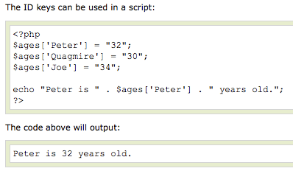
PHP Associative Arrays

Slide 12
PHP Multidimensional Arrays
In a multidimensional array, each element in the main array can also be an array.
And each element in the sub-array can be an array, and so on.

Slide 13
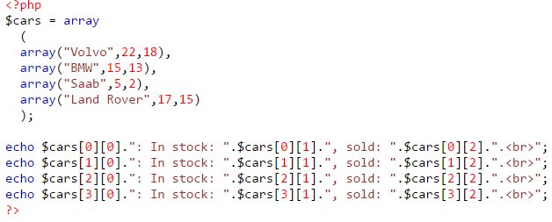
PHP Multidimensional Arrays
Volvo: In stock: 22, sold: 18. BMW: In stock: 15, sold: 13. Saab: In stock: 5, sold: 2. Land Rover: In stock: 17, sold: 15.

Slide 14
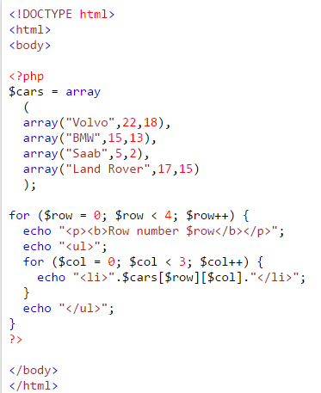
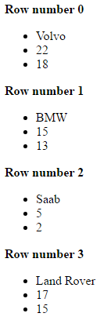
PHP Multidimensional Arrays

Slide 15
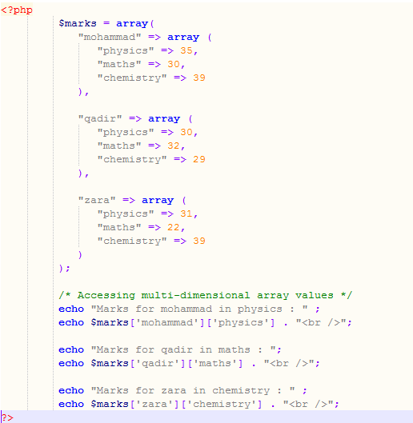

PHP Multidimensional Arrays

Slide 16
Insert Element in Array
array_push() function inserts one or more elements to the end of an array.
Syntax
array_push(array,value1,value2...)
array_slice() function returns selected parts of an array
Syntax
array_slice (array, start, length, preserve)
Parameter | Description
array | Required. Specifies an array
start | Required. Numeric value. Specifies where the function will start the slice. 0 = the first element. If this value is set to a negative number, the function will start slicing that far from the last element. -2 means start at the second last element of the array.
length | Optional. Numeric value. Specifies the length of the returned array. If this value is not set, the function will return all elements, starting from the position set by the start-parameter.
preserve | Optional. Specifies if the function should preserve or reset the keys. Possible values: true - Preserve keys, false - Default. Reset keys

Slide 17
Removing values from arrays
> Sometimes you need to completely remove an element from an array. For example, suppose you have the following array with five elements:
$cities[0] = “Phoenix”;
$cities[1] = “Tucson”;
$cities[2] = “Flagstaff”;
$cities[3] = “Tempe”;
$cities[4] = “Prescott”;
> Now you decide that you no longer want to include Tempe, so you use the following statement to try to remove Tempe from the array:
$cities[3] = “”;
Although this statement sets $cities[3] to an empty string, it doesn’t remove the element from the array. You still have an array with five elements, but one of the five values is empty. To totally remove the element from the array, you need to unset it with the following statement:
unset($cities[3]);
var_dump($cities);
Now your array has only four elements in it, as follows:
$cities[0] = “Phoenix”;
$cities[1] = “Tucson”;
$cities[2] = “Flagstaff”;
$cities[4] = “Prescott”;

Slide 18
PHP Loops
> Often when you write code, you want the same block of code to run over and over again in a row. Instead of adding several almost equal lines in a script we can use loops to perform a task like this.
> In PHP, we have the following looping statements:

Slide 19
PHP Loops
> while - loops through a block of code while a specified condition is true
> do...while - loops through a block of code once, and then repeats the loop as long as a specified condition is true
> for - loops through a block of code a specified number of times
> foreach - loops through a block of code for each element in an array

Slide 20
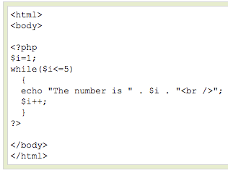
PHP Loops - While
The while loop executes a block of code while a condition is true. The example below defines a loop that starts with
i=1. The loop will
continue to run as
long as i is less
than, or equal to 5.
i will increase by 1
each time the loop
runs:

Slide 21
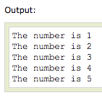
PHP Loops - While

Slide 22
PHP Loops – Do ... While
The do...while statement will always execute the block of code once, it will then check the condition, and repeat the loop while the condition is true.
The next example defines a loop that starts with i=1. It will then increment i with 1, and write some output. Then the condition is checked, and the loop will continue to run as long as i is less than, or equal to 5:

Slide 23
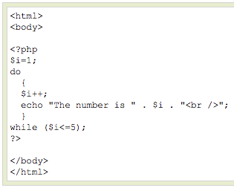
PHP Loops – Do ... While

Slide 24
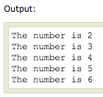
PHP Loops – Do ... While

Slide 25
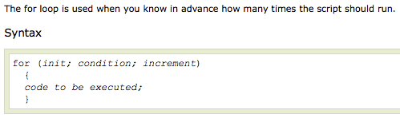
PHP Loops - For

Slide 26
PHP Loops - For
Parameters:
> init: Mostly used to set a counter (but can be any code to be executed once at the beginning of the loop)‏
> condition: Evaluated for each loop iteration. If it evaluates to TRUE, the loop continues. If it evaluates to FALSE, the loop ends.
> increment: Mostly used to increment a counter (but can be any code to be executed at the end of the loop)‏

Slide 27
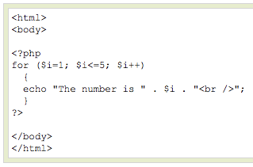
PHP Loops - For
The example below defines a loop that starts with i=1. The loop will continue to run as long as i is less than, or equal to 5. i will increase by 1 each time the loop runs:

Slide 28
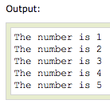
PHP Loops - For

Slide 29

PHP Loops - Foreach
For every loop iteration, the value of the current array element is assigned to $value (and the array pointer is moved by one) - so on the next loop iteration, you'll be looking at the next array value.

Slide 30
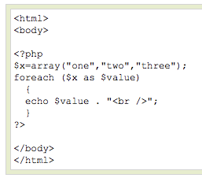

PHP Loops - Foreach
The following example demonstrates a loop that will print the values of the given array:

Slide 31
PHP Functions
> We will now explore how to create your own functions.
> To keep the script from being executed when the page loads, you can put it into a function.
> A function will be executed by a call to the function.
> You may call a function from anywhere within a page.

Slide 32

PHP Functions
A function will be executed by a call to the function.
> Give the function a name that reflects what the function does
> The function name can start with a letter or underscore (not a number)‏

Slide 33
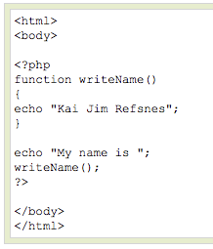
PHP Functions
A simple function that writes a name when it is called:

Slide 34
PHP Functions - Parameters
Adding parameters...
> To add more functionality to a function, we can add parameters. A parameter is just like a variable.
> Parameters are specified after the function name, inside the parentheses.

Slide 35
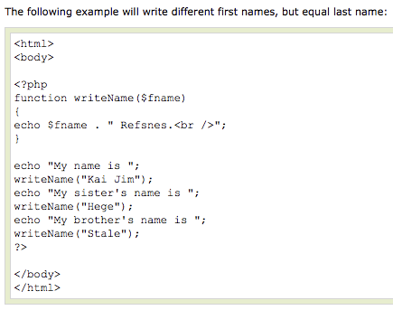

PHP Functions - Parameters

Slide 36
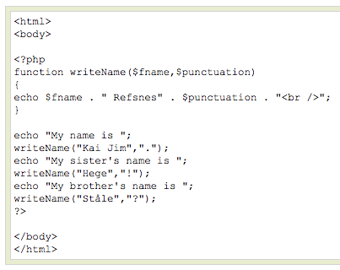

PHP Functions - Parameters

Slide 37
END

